Slide 1

eHealth/mHealth for PTSD: Development, Research, & Implementation

Slide 2


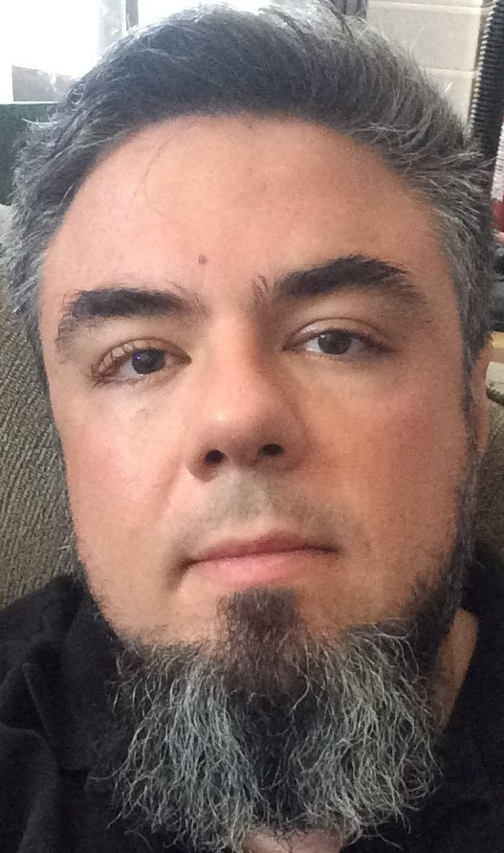
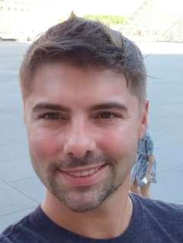



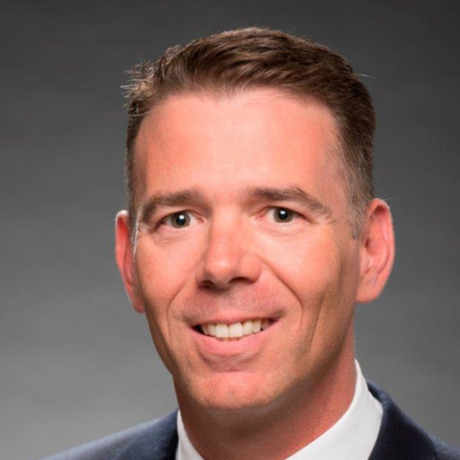
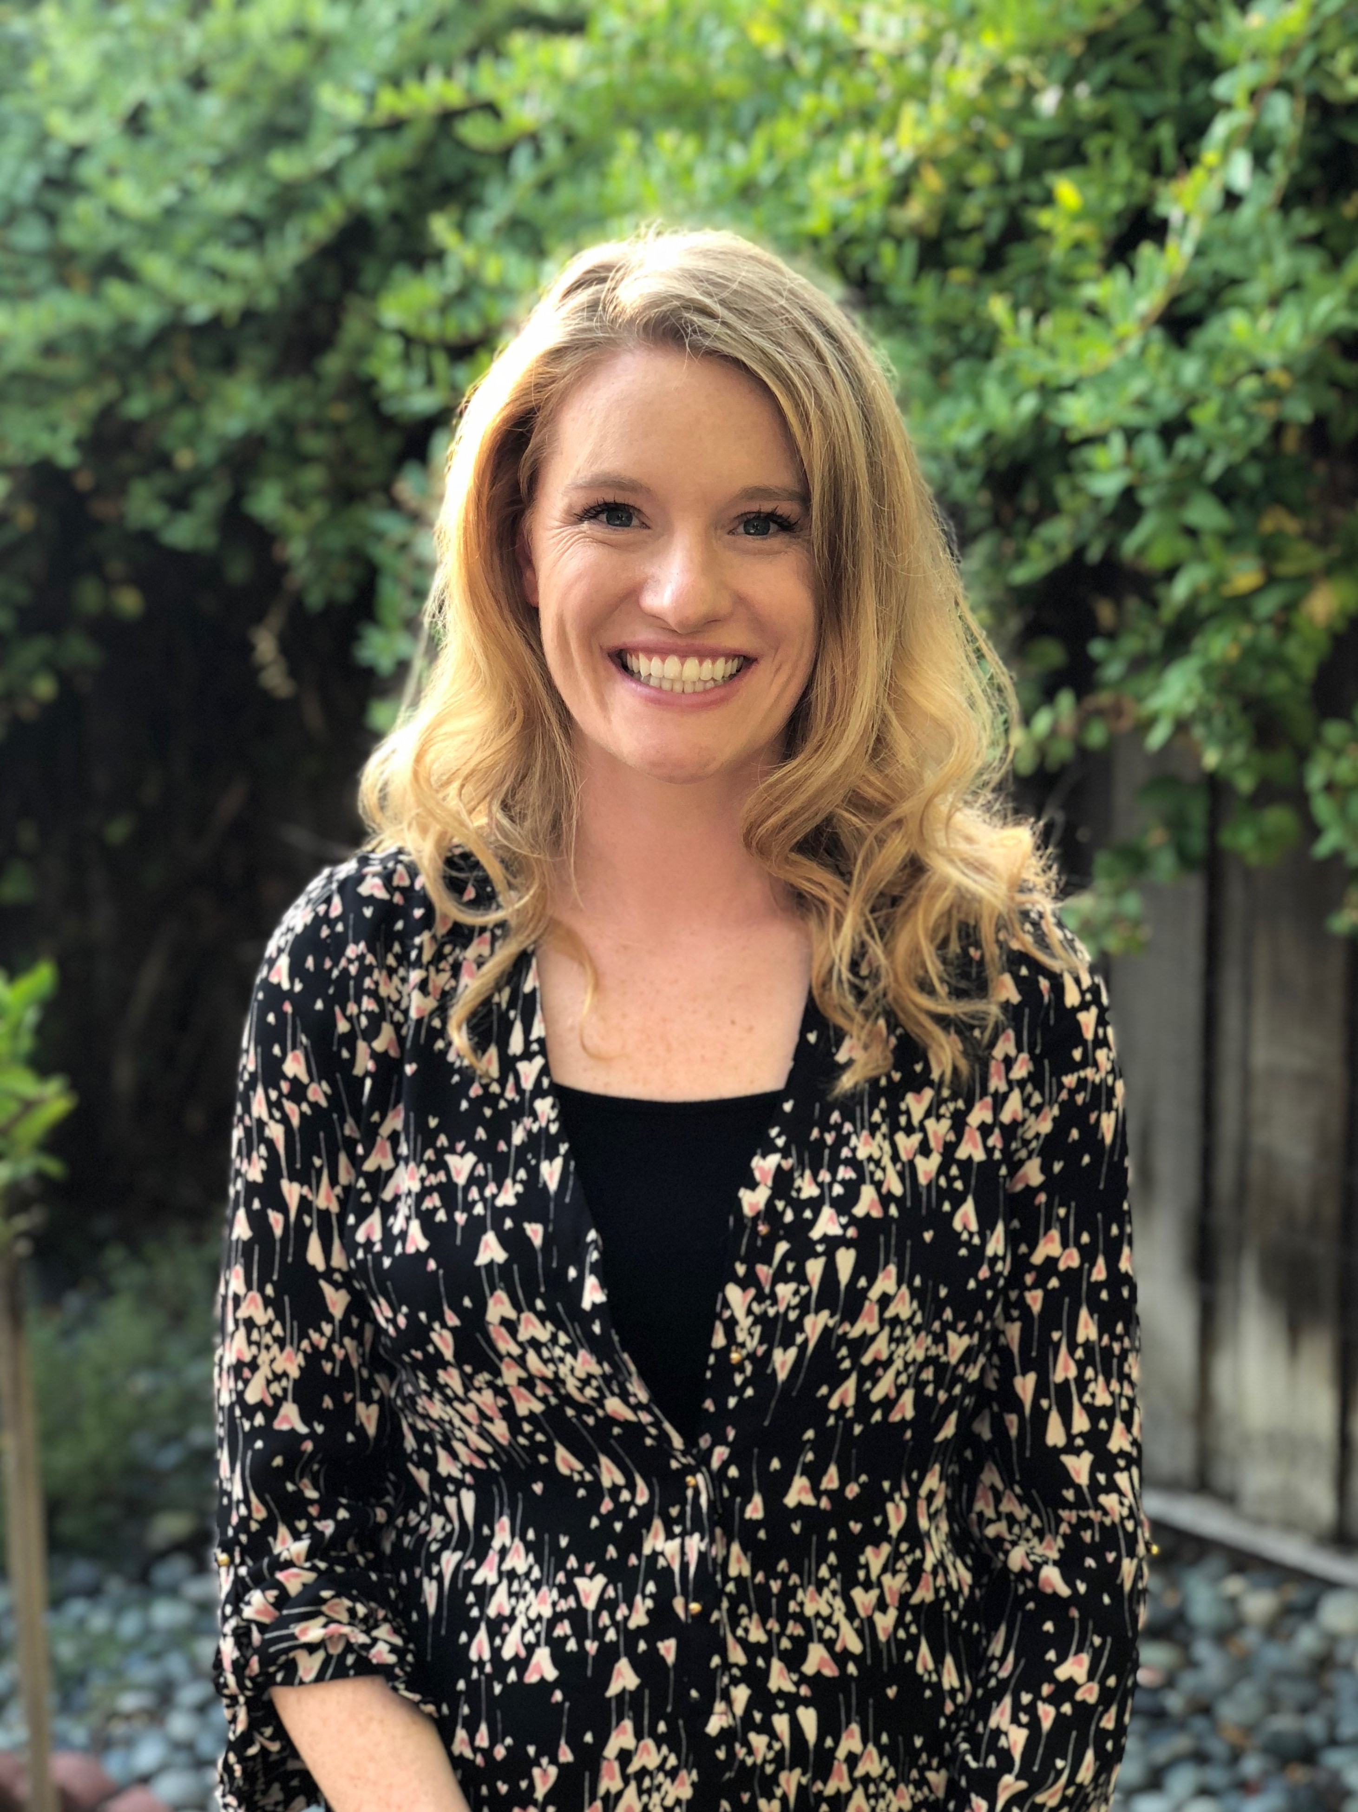


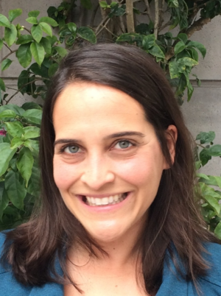
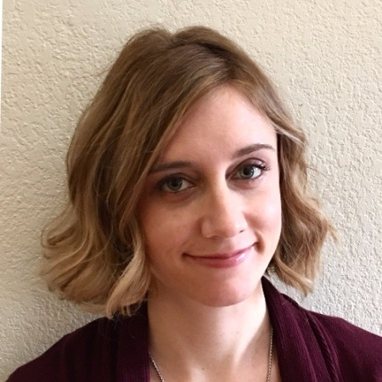
NCPTSD Tech Team
Julia Hoffman
Shannon McCaslin
Kelly Ramsey
Katie Juhasz
Kile Ortigo
Robyn Walser
Eve Carlson
Pearl
McGee-Vincent
Eric Kuhn
Sarah Steinmetz
Maggi Mackintosh
Jason Owen
Steve Woodward
Andrew Chang
Beth Jaworski
Carmen McLean
Katie Taylor-Lynch

Slide 3
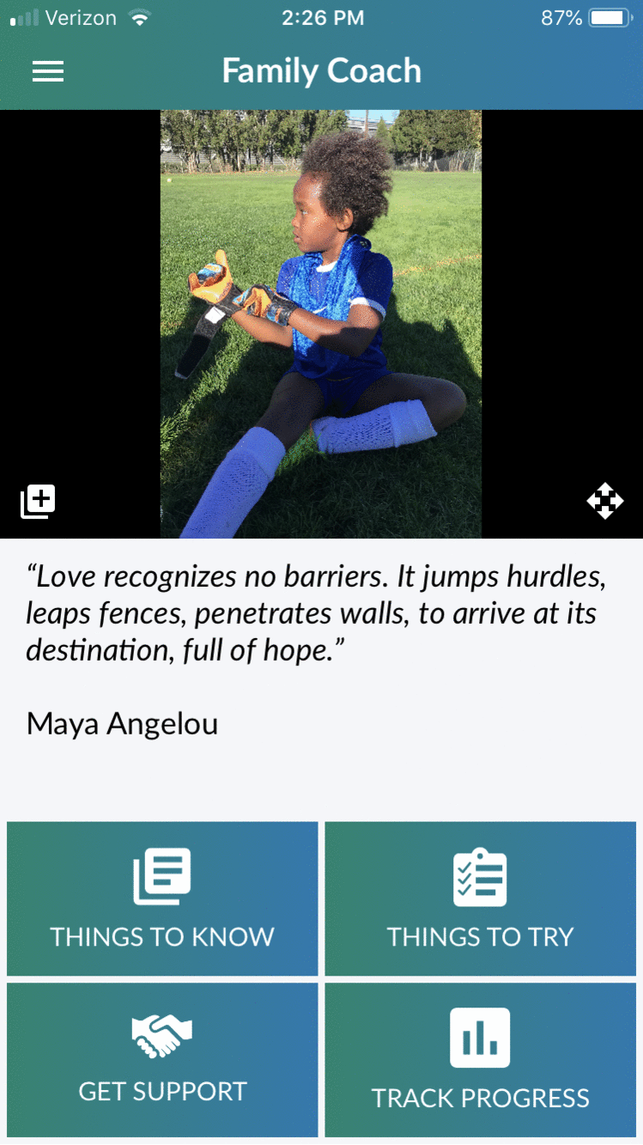

Recently-Released Products
Completely re-factored & updated code to address issues of aging app
Personalized home screen
Automated, tailored coaching messages
Dozens of new tools
Dozens of new learn topics
Join a conversation (Twitter integration)
Custom goals
Track Progress major upgrades to include PCL5 Partner Version, Warwick Edmonton Emotional Well-Being Scale
Dynamic treatment locators
PTSD Family Coach
(iOS, Android)

Slide 4
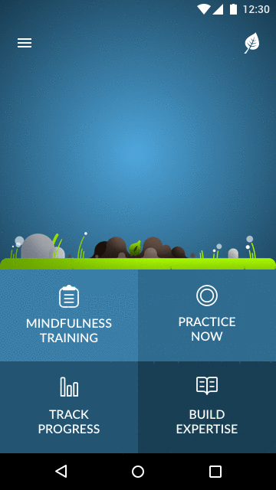
Recently-Released Products
User Experience Feedback
User Reviews
16k downloads in Sept 2018 (3.5x PTSD Coach)
4.6/5 iOS; 4.7/5 Android
Firebase dynamic content (MindSTRIDE)
Grant submissions
Mindfulness Coach 2.0 (iOS, Android)

Slide 5
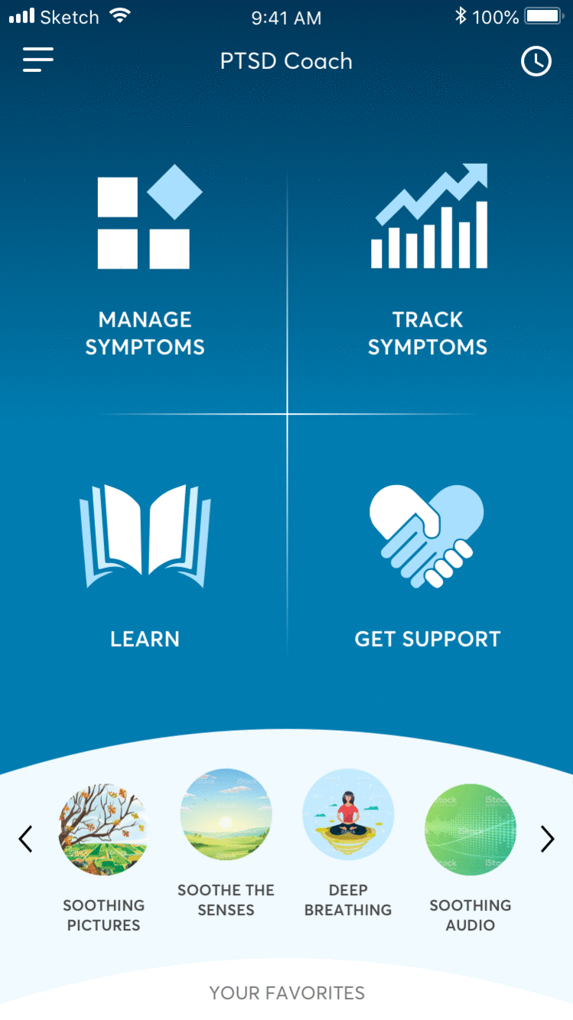
Updates in Progress
PTSD Coach 3.1 (iOS/Android)
Updated user interface
Additional tools to address most-reported/prevalent symptoms
Spanish-language version
STAIR 2.0 (Android)
Updated UI with training plan
Additional tools, learn topics to match webSTAIR
Gamification, better UX for mood logging
VetChange Research & 2.0 (Android)
Sync with VetChange website
Elevation of motivational elements
New tools, learn topics, check-in procedure to match VetChange website

Slide 6
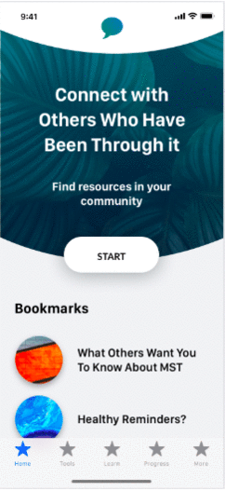
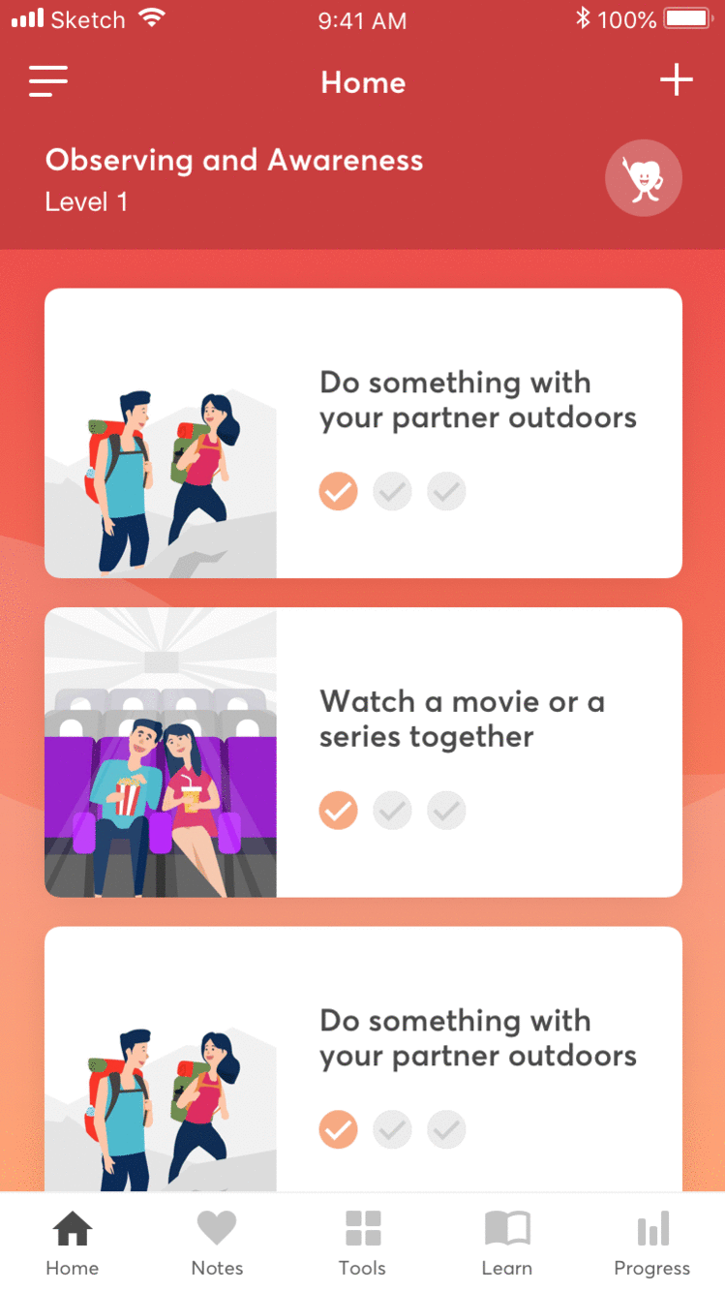
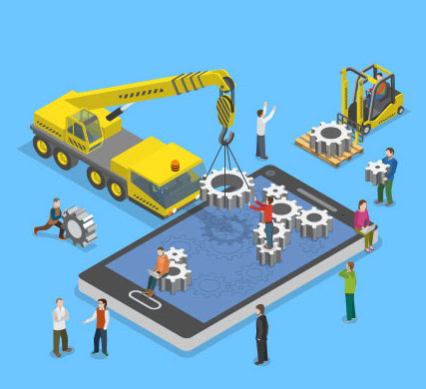
New App Development
Beyond MST
Couples Coach
R-PRO Measurement

Slide 7
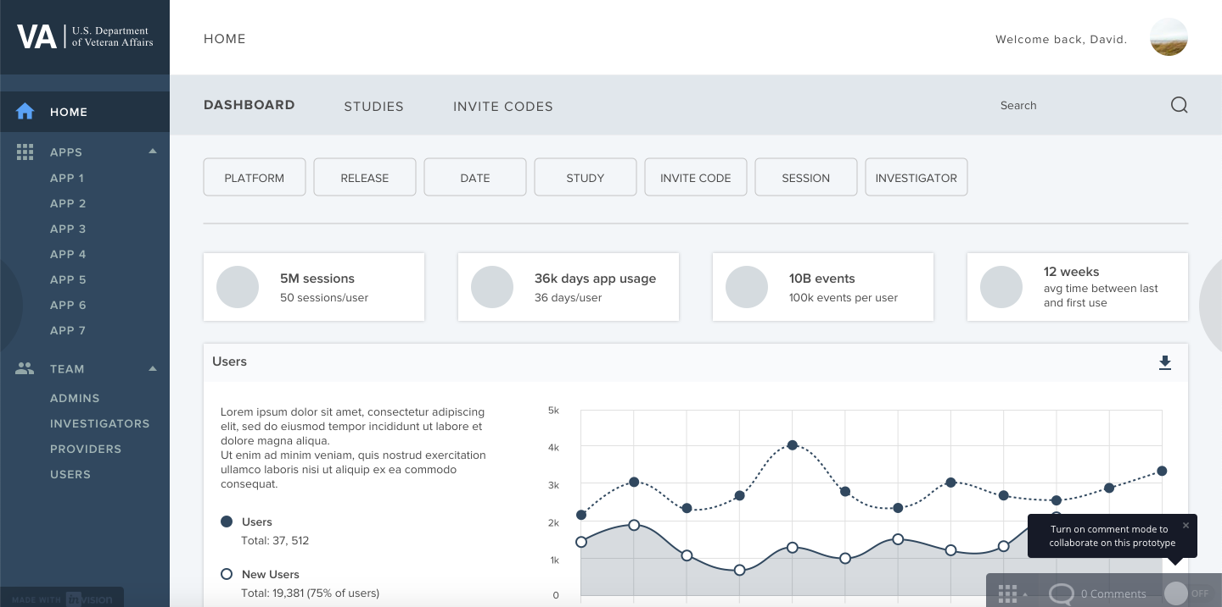
Analytics Platform (AppViewConnect)
AppViewConnect

Slide 8
Sustainment – bug squashing & feature upgrades
ACT Coach (iOS) - improved data handling reliability
AIMS (iOS) - made it a universal app for iPad, fixed some bugs, improve data handling reliability
CBT-i Coach (iOS) - fixed a crash bug, upgraded sleep diary time controls to respect device's localization settings
CBT-i Coach (Android) - fixed a crash bug when exporting user data
Concussion Coach (Android) - restored a missing About section and added the now-mandatory privacy policy
CPT Coach (iOS) - improved data handling reliability
CPT Coach (Android) – app completed from incomplete code base / app released
Mindfulness Coach (iOS) - fixed bug when using Button Shapes accessibility feature
Mindfulness Coach (Android) - fixed freeze when device has a firewall, freezes with seated practice tool
Moving Forward (iOS) - fixed miscellaneous bugs
Mood Coach (iOS) - made it a universal app for iPad, fixed miscellaneous bugs
Parenting2Go (iOS) - made it a universal app for iPad, fixed miscellaneous bugs
PFA Mobile (iOS) - fixed miscellaneous bugs
PTSD Coach (iOS) - code modernized, fixed missing iPad icon and made it a universal app for iPad
PTSD Coach (Android) – fixed a crash bug with assessment graph, impending update to fix graph scrolling bugs
STAIR Coach (iOS) – fixed miscellaneous bugs, impending update to fix some new iOS 11 & iOS 12 bugs
Stay Quit Coach (Android) – impending update to fix miscellaneous bugs, add the now-mandatory privacy policy
VetChange (iOS) – impending update to fix miscellaneous bugs, improve readability of text screens

Slide 9
Sustainment – bug squashing
Yearly major updates of mobile platforms (iOS, Android) often introduce new bugs
Minor updates of mobile platforms throughout the year can introduce new bugs
Bugs can slip by QA (rare use cases, device fragmentation)
Maintainers can identify flaws in original developer’s code
Code portions can become obsolete
Web site URLs can become obsolete
Mobile platforms can add new mandates (e.g., privacy policy)

Slide 10
Sustainment – feature upgrades
Customers can report needs (non-protocol) that we did not anticipate
Population segments (e.g., older customers who need larger text)
Use patterns (e.g., listening to quiet mindfulness audio on speaker)
Device configurations (e.g., compatibility with international dates)
Preference constraints (e.g., firewall app blocks dynamic content)
How care is delivered (e.g., providers review PE info a certain way)
Regular refinements to improve UI and UX
Improve screen flows / remove annoyances
Address compromises from development (e.g. background audio)
UI can become dated-looking as iOS & Android change their looks
iPad / tablet compatibility

Slide 11
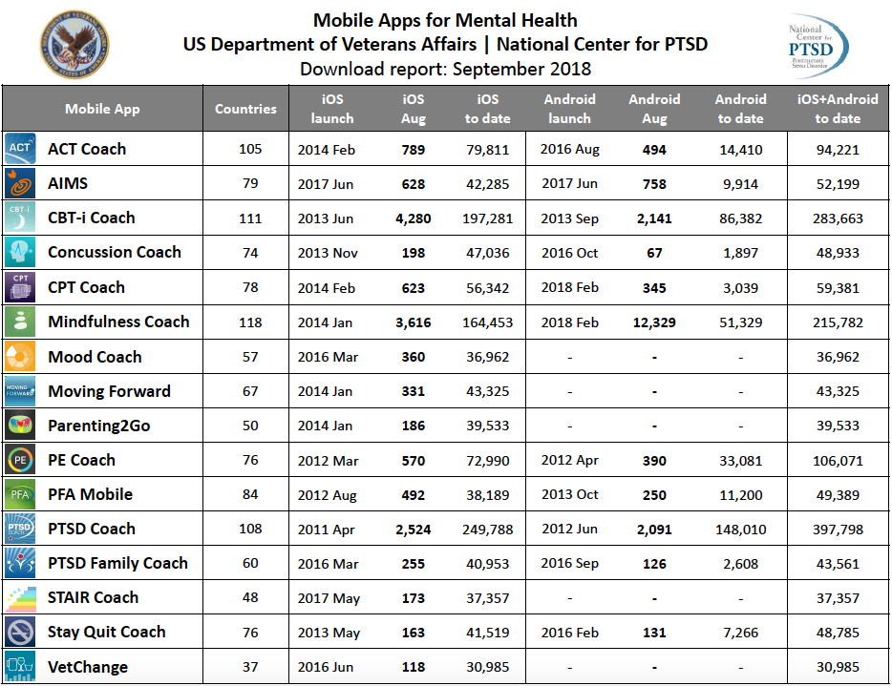

Slide 12
PBI Network/Tech Into Care
INSERT FROM KATIE

Slide 13
Suicide Safety Planning
INSERT FROM KATIE

Slide 14
Dissemination & Veteran Experience
Insert from KATIE
Media:
NPR on cbticoach.org
Marketplace Tech
DoD Podcast
WSJ Future of Everything
VAPAHCS Podcasts

Slide 15
Center for Mobile Apps Research Services & Support (CMARSS)
9/18 national meeting of VA tech researchers

Slide 16
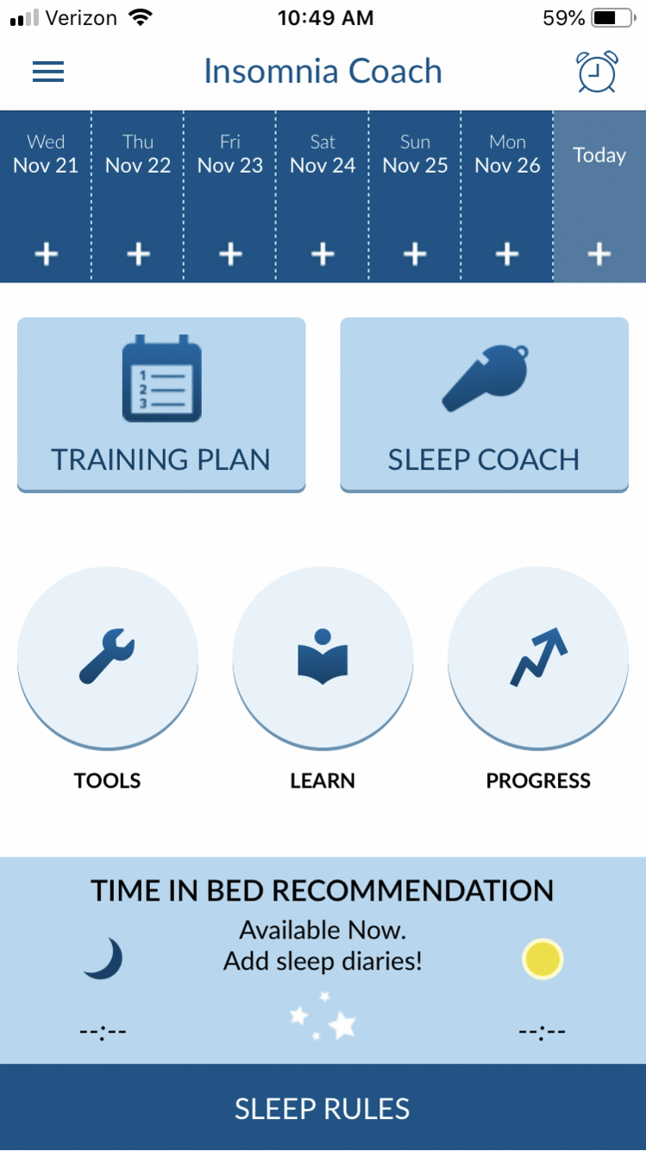
Insomnia Coach
Pilot study received IRB approval
Safety & feasibility testing prior to public release
Planned connection with cbticoach.org

Slide 17
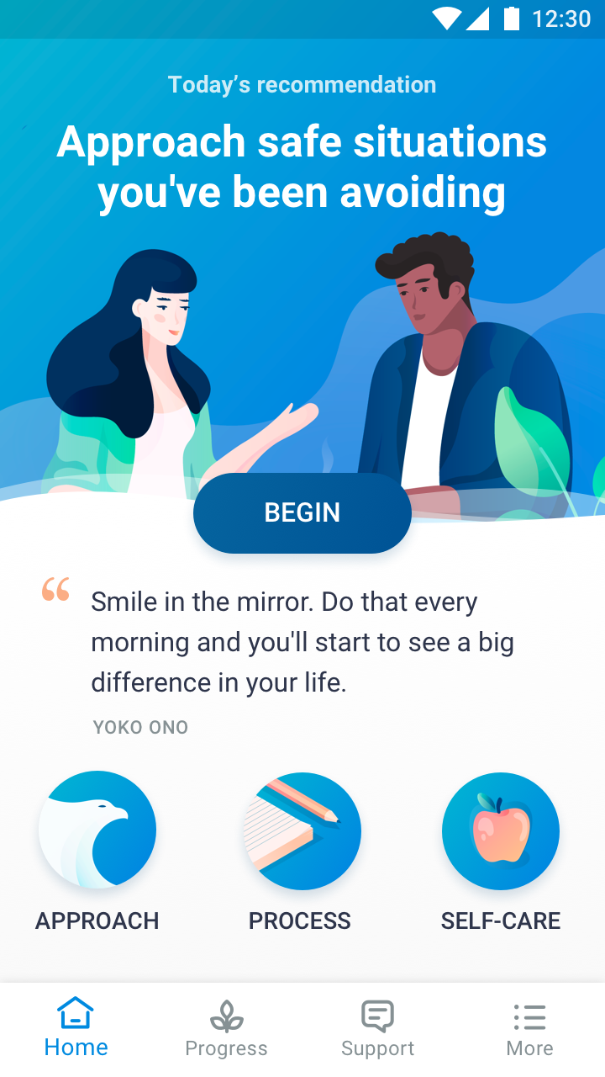
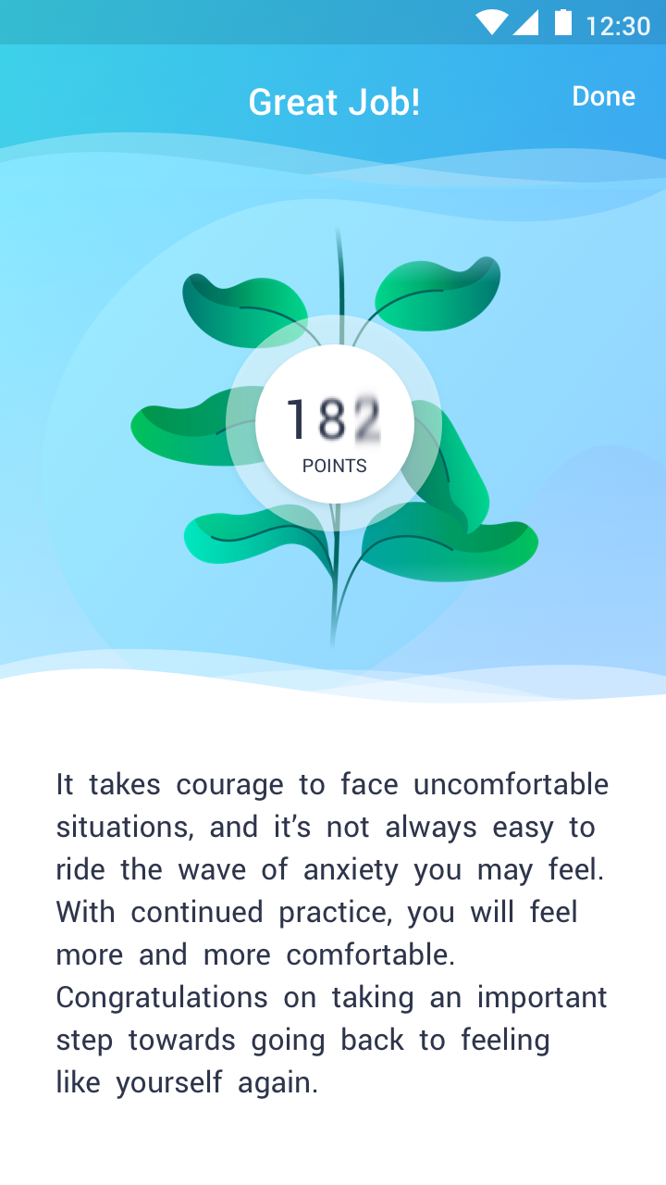
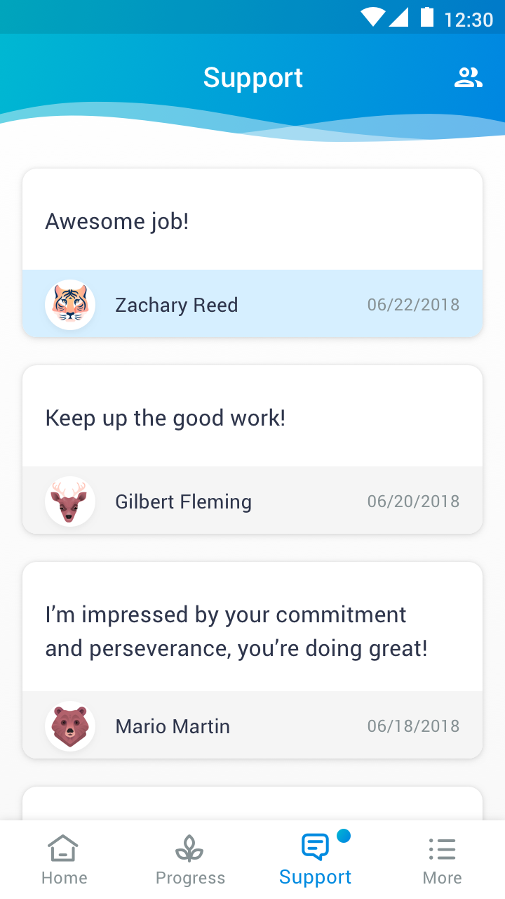
RENEW Self-guided exposure for PTS symptoms
Primary activities: Approach (in vivo exposure), Process (written/narrated exposure), and Self-Care (focus on relaxation, social connection, physical activity)
Gamification: Earn points by engaging with the app (weighted towards therapeutic exercises). Achieve new levels and watch the Renew plant grow.
Peer support: Support team can reinforce user’s engagement with Renew and prompt following non-engagement to increase accountability and social connection.
Notes:
Note: motivations (quotes, photos, about face video clips) to personalize and remind during exposure
Note: 5-item assessment with feedback periodically to track progress

Slide 18




Situating Peer Support Services along the Continuum of Care
Maggi Mackintosh
Characterize those who benefit sufficiently from peer support services compared to those who request clinician-based care
How outcomes are related to engagement in CBT work
Mediational models of the role of peer support services on homework, skill development, self-efficacy, etc.
Transition to Clinician Care?
Qualities of Interactions
Pilot processes & hypothesis generation for grant
Who Benefits from Peer Support?
Vets Prevail Observational Study
500 Veterans followed + assessments
Use of current ORH-funded online peer support system
Tracking Peer Coaching attitudes and behaviors
Identify patterns predicting better functional outcomes
Describe Veteran users and online engagement patterns

Slide 19
Mackintosh: AIMS 2019
Pilot AIMS – Internal Funding
* 20 in AIMS and AIMS + Coaching
* Uptake, attrition & ES estimates
* Piloting recruitment methods
* Finalizing clinical processes & manual
CSR&D App - Efficacy Trial
* Efficacy of AIMS (with & without Coaching) vs Wait-List Control
* Suicide Prevention: Improving social support & interpersonal functioning and reducing MH concerns
AIMS Tech Integration for Clinicians
* Clinician dashboard for online & mobile app data tracking
* Structured to support clinically relevant info (Anger Control Plan)
* Grant prep: NIMH High-Priority Areas for Research on Digital Health Tech
AIMS 2.0
* Conducted by Mental Health Services
* Updating Technology
* AIMS-focused Veteran stories rather than AMT

Slide 20
71 BPM
62 BPM
62 BPM
Quetiapine titration 100 to 300 mg
57 BPM
Slope = .33 BPM/day
61 BPM
Slope = -.02 BPM/day
No med changes
Prazosin 4 mg on board

Slide 21
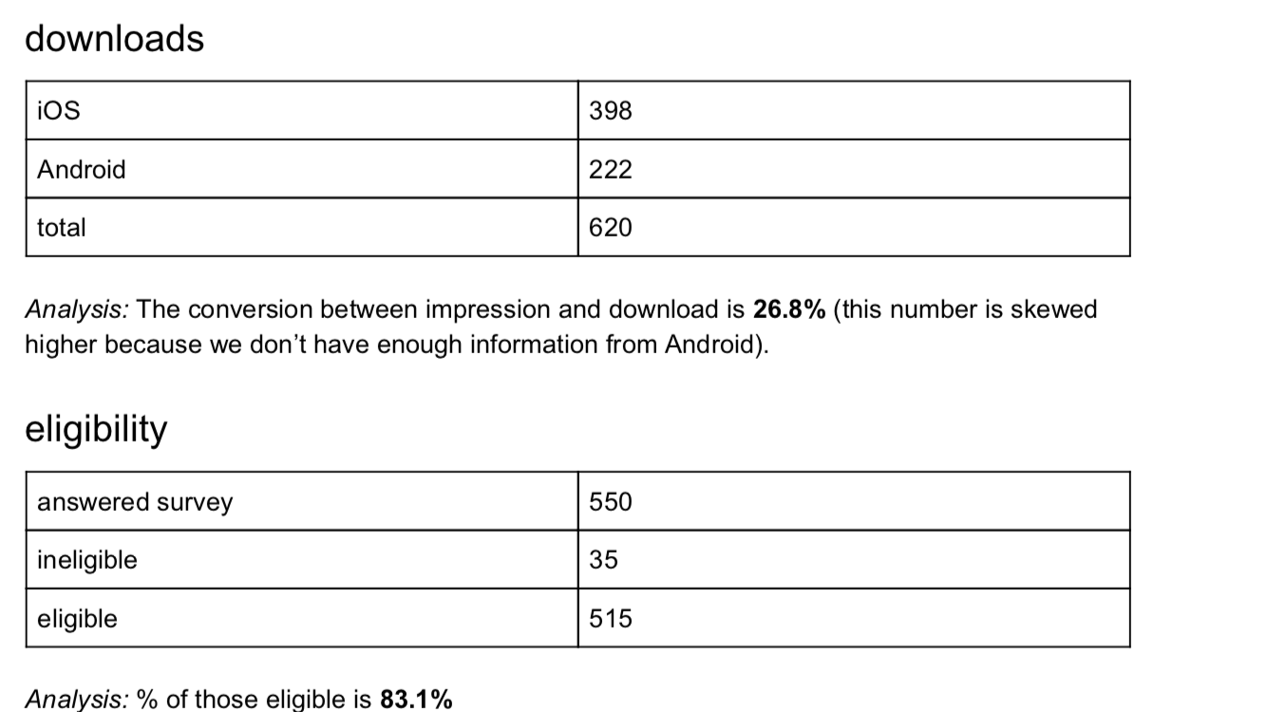
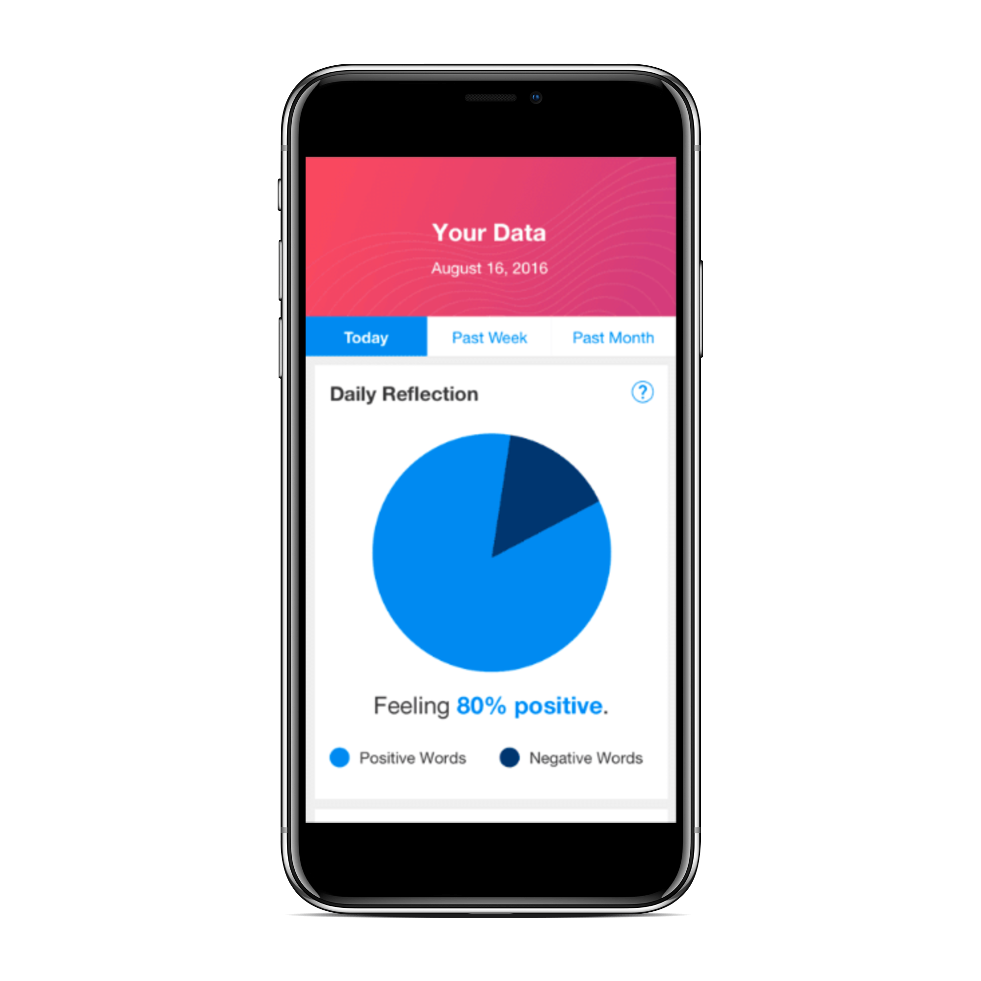
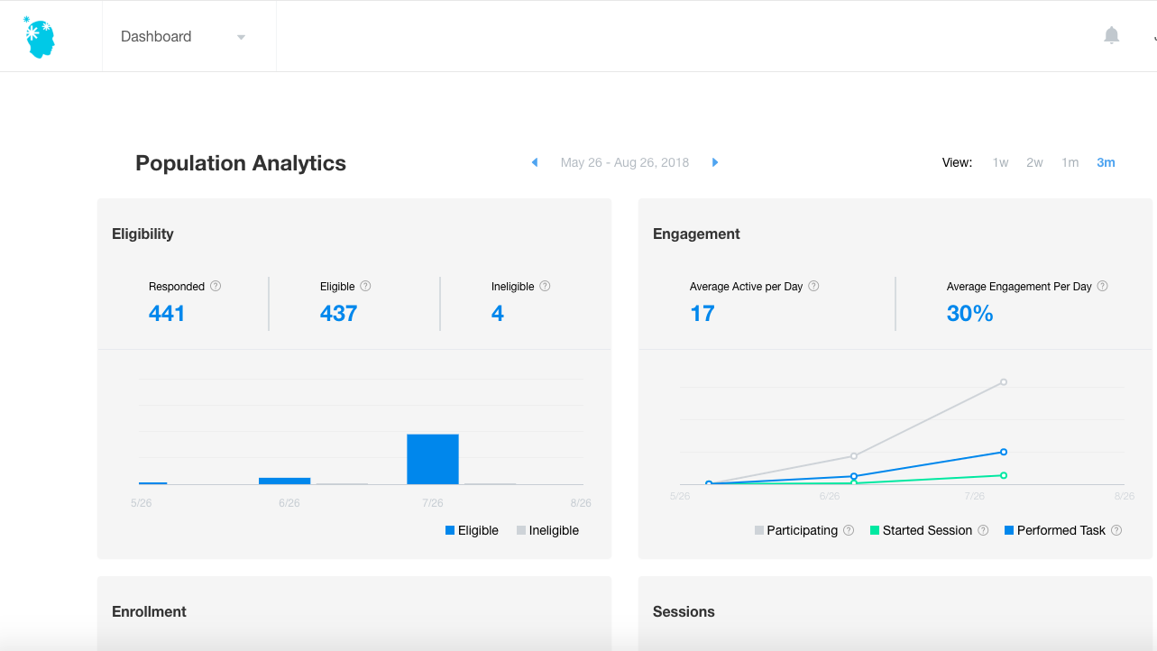
The AWARE Study

Slide 22
COMMUNITY PROVIDER TOOLKIT VERSION 2.5
Collaborative work with stakeholders and Lab at OPM
Based on user research: updates and enhancements planned –
Enhanced emphasis on screening and military culture
Increased visibility of crisis management guidance and resources
New topics such as serving Native American Veterans/Reduce redundancy with other sites (e.g., suicide prevention)
Completed evaluation with 68 (eligible for follow-up) providers from the community (data analysis/manuscript in progress)

Slide 23

VHA Innovators Network

Slide 24
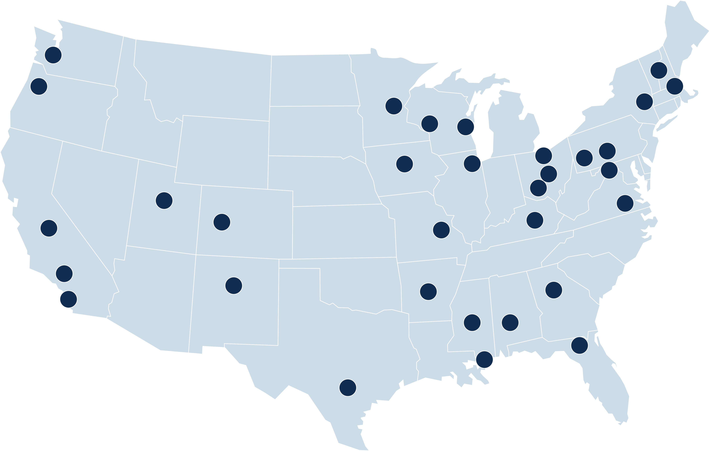
VHA Innovators Network Overview
Currently at 32 VA Medical Centers across the US
Serves as a safe space for VA employees to test new ideas and join forces with stakeholders across the Veteran community to improve the way VA serves Veterans
Encourages and invests in employees who wish to recognize and address the system’s greatest challenges
Provides employees with training, tools, and resources to bring their innovative ideas to life
Building Innovation Capacity by Engaging Employees in the Field

Slide 25
VA Innovators Network Goals
Teach and train VA employees on innovation-related competencies to build the innovation muscle of VA
Generate new ways of serving Veterans through the Spark-Seed-Spread Innovation Investment Program and the Investee Accelerator
Support the Diffusion of Excellence Initiative by fueling promising practice identification and implementation at VHA Innovators Network sites

Slide 26

Overview of Spark-Seed-Spread
The Spark-Seed-Spread Innovation Investment Program seeks innovative concepts and practices from all VA employees
The program serves as a mechanism to identify, support, and accelerate innovations that improve experiences for Veterans and employees
Notes:
Provide carved out time

Slide 27



Funding Levels
Spark Investments ($5-10K)
Develop initial proof of concept ‘prototypes’ with a strong problem statement and some preliminary evidence or strong theory of action.
Seed Investments (~$50K)
Further develop proof of concept and test it in the form of a pilot. Projects need a moderate evidence base and will undergo testing and validation of effectiveness.
Spread Investments ($100-$200K)
Spread, diffuse, or scale innovation projects to other clinics or sites at VA. Eligible practices must have evidence to support suitability for scaling and have undergone vetting by appropriate stakeholder groups and proven effective through pilot or replication studies.
Notes:
Provide carved out time

Slide 28
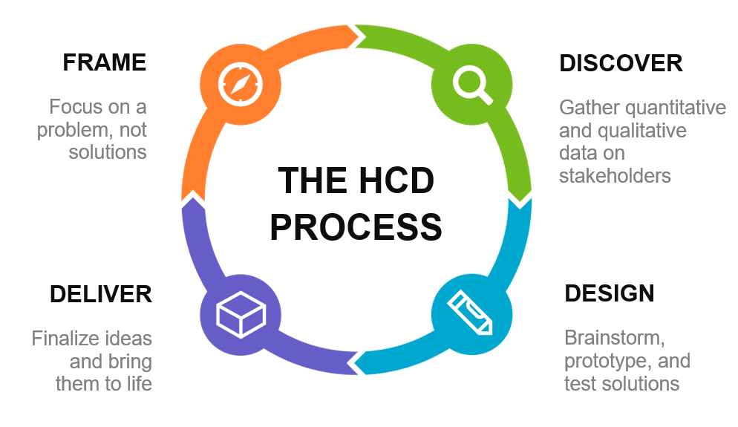
Human-Centered Design (HCD)
HCD is a creative approach to problem solving that starts with people and ends with innovative solutions tailor made to suit users’ needs. HCD helps to develop and refine VA Innovators Network practices.

Slide 29
Research Partnerships
VA Puget Sound
VA Minneapolis
Hampton Roads VA
San Francisco VA
Pittsburgh VA
OPM
USC
Duke University
Rand
Stanford
University of Hawai’i
University of Colorado

Slide 30
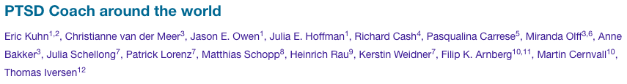
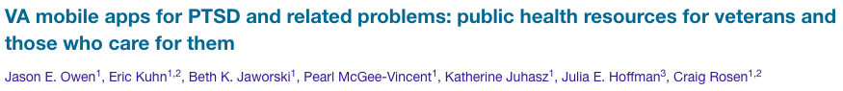
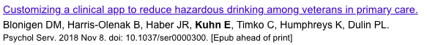
Ongoing Research

Slide 31
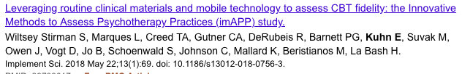
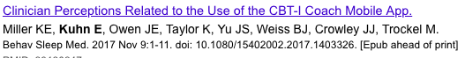
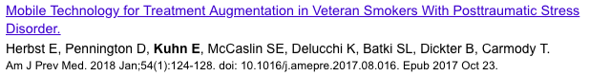
Ongoing Research

